Slide 1
Phosphorus in Utah Lake Sediments Greg Carling, Matt Randall, Steve Nelson, Barry Bickmore, Neil Hansen, Theron Miller

Slide 2
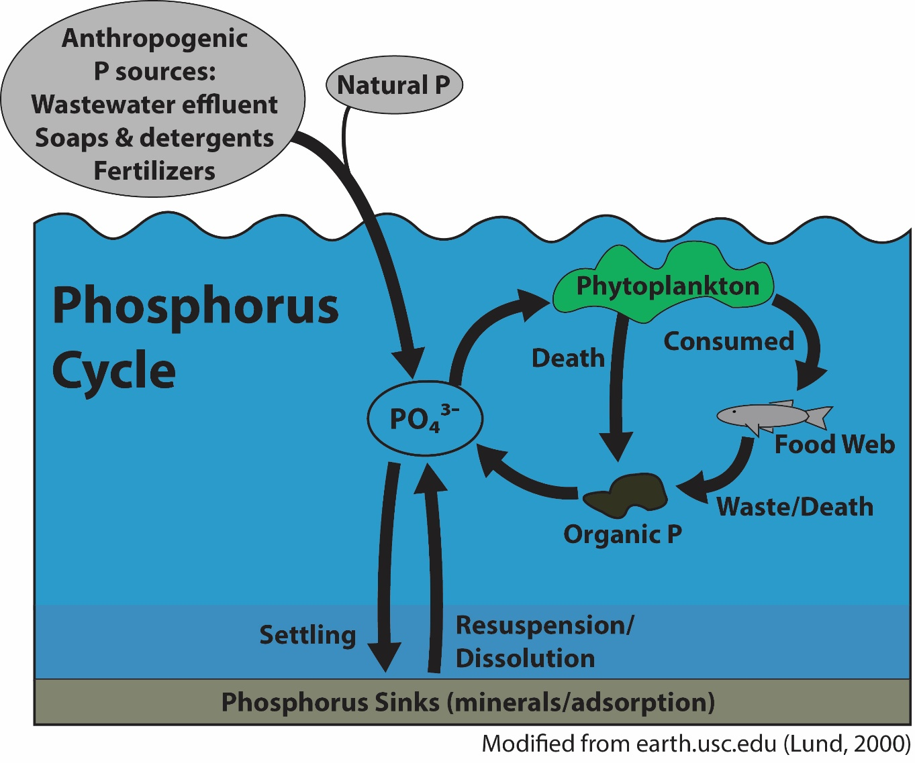
Modified from earth.usc.edu (Lund, 2000)

Slide 3
Research Questions
What is the fate of phosphorus inputs to Utah Lake?
Adsorption?
Mineral precipitation?
What is the mobility of phosphorus in Utah Lake sediments?
Loosely sorbed?
Mineral bound?

Slide 4
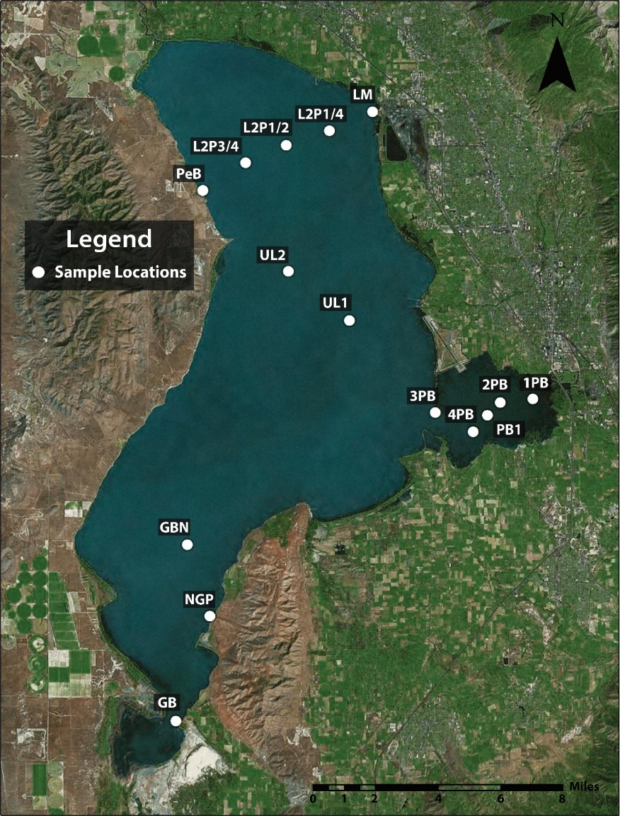
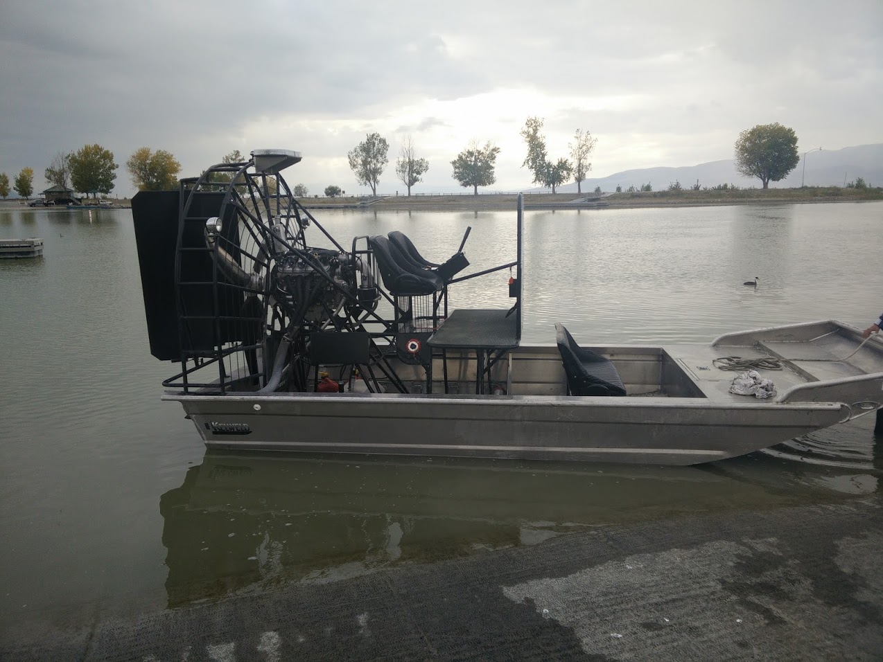
Sampling locations
Google Earth

Slide 5
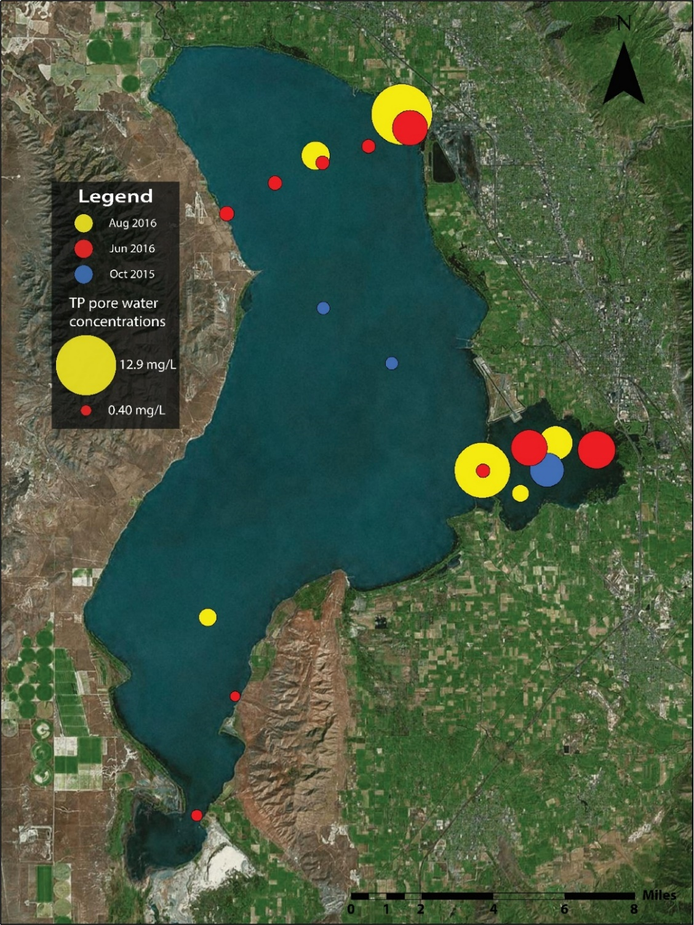
Pore water total P

Slide 6
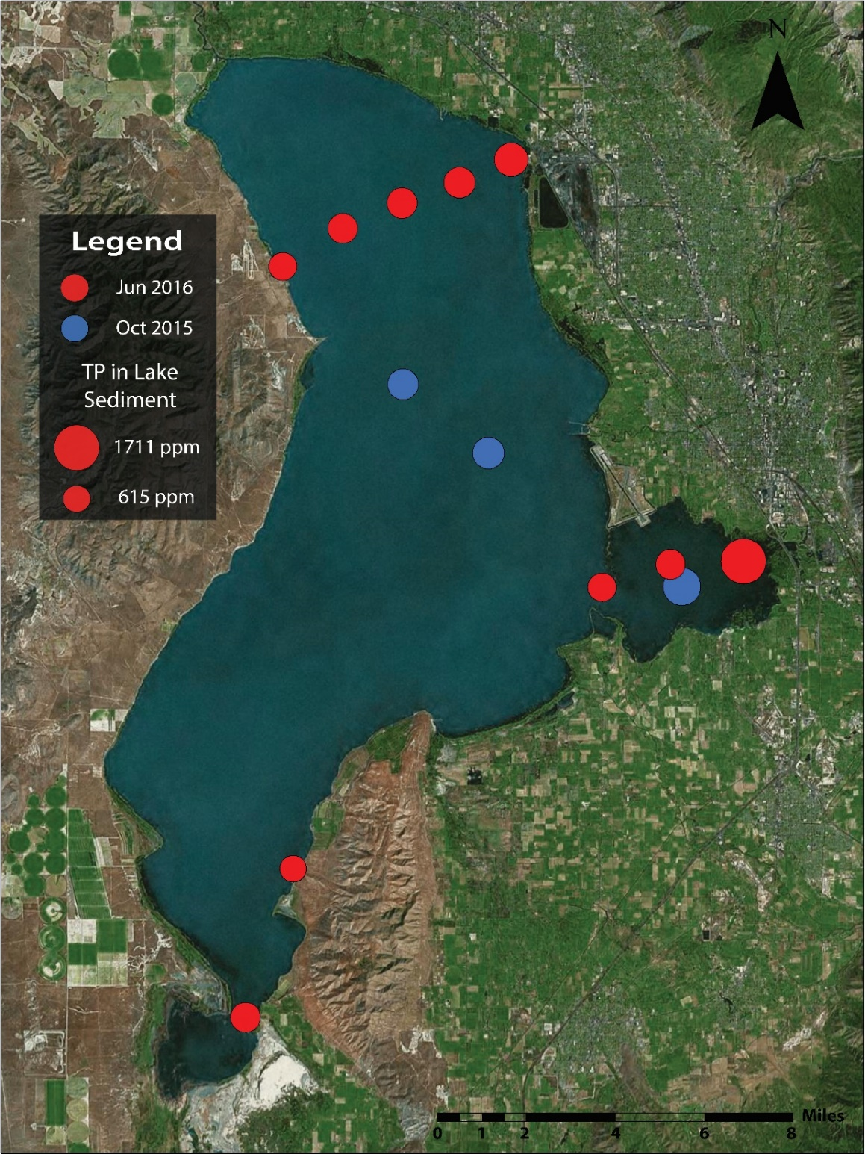
Sediment total P

Slide 7
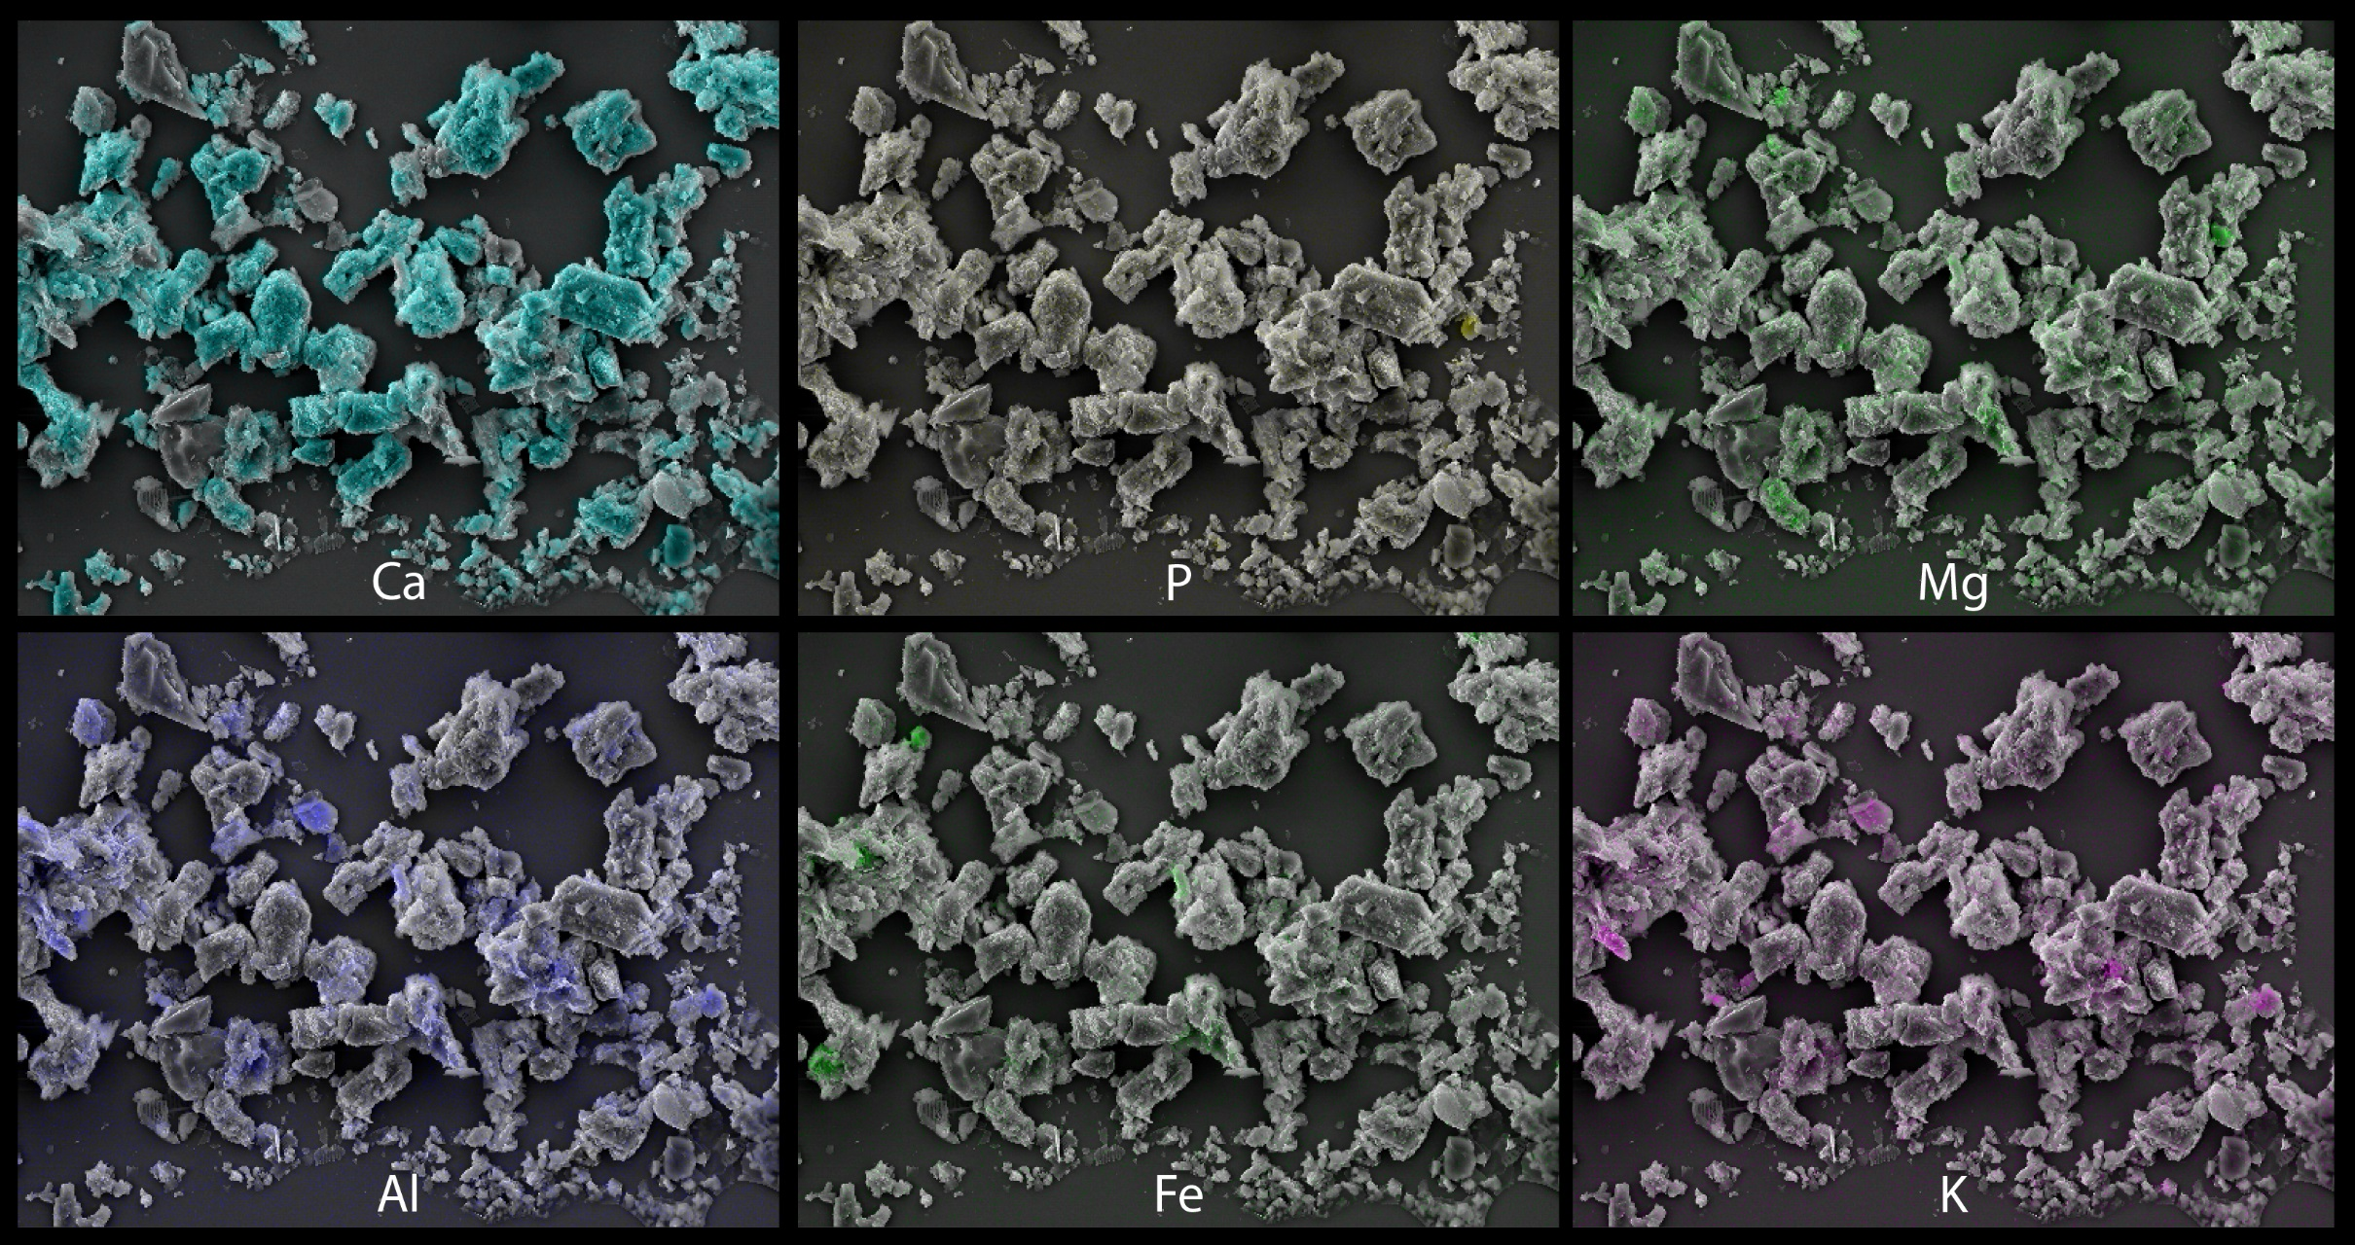
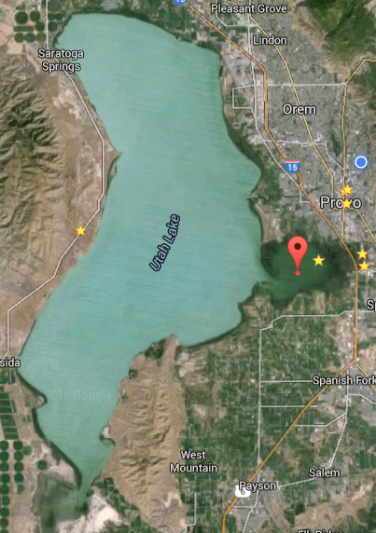
Provo Bay sediment
Sample site Provo Bay sediment

Slide 8
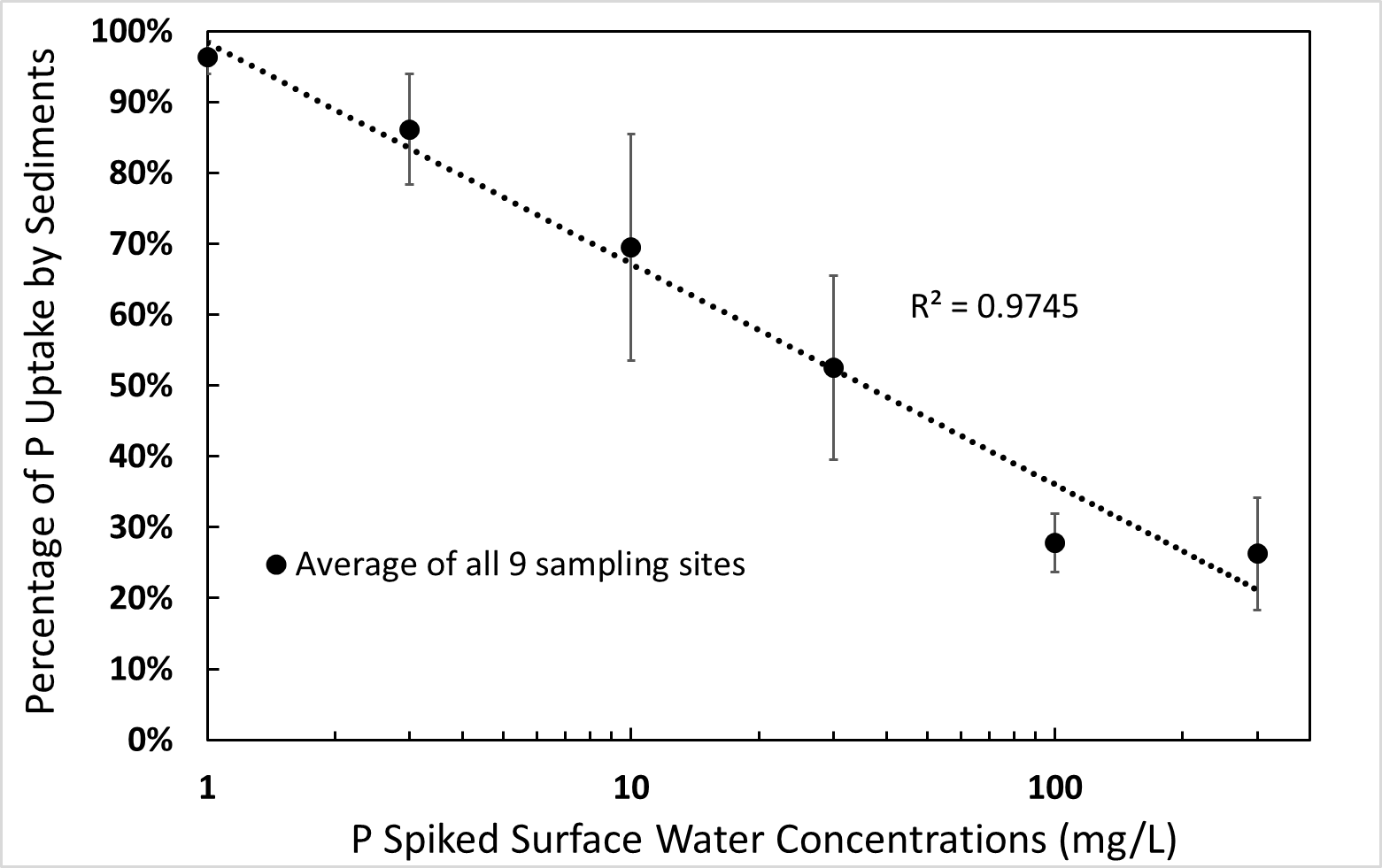
Batch Sorption – Lake Sediments

Slide 9
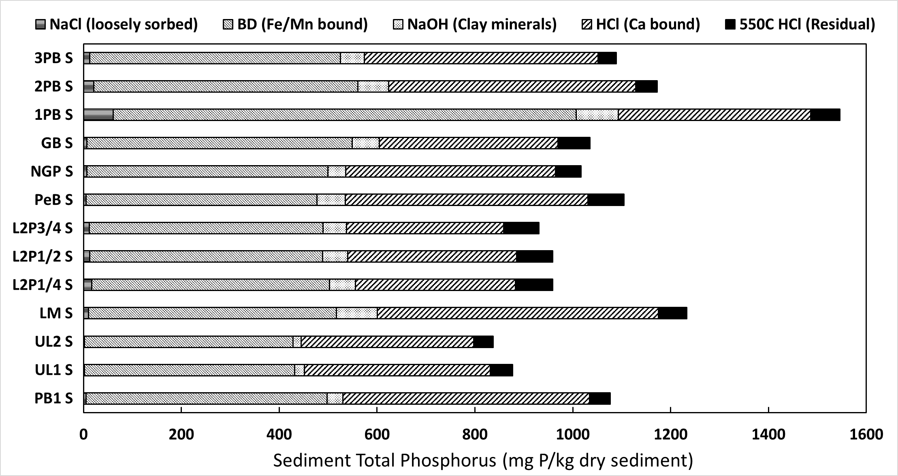
Sequential Leaching – Lake Sediment

Slide 10
Conclusion
Phosphorus sinks/mobility in Utah Lake
Calcium minerals (~50%) → Immobile
Fe/Mn oxyhydroxides(~50%)→Mobile (redox sensitive)
Pore water (high TP)→Highly mobile
Phosphorus cycling from sediment to water column

